Slide 1
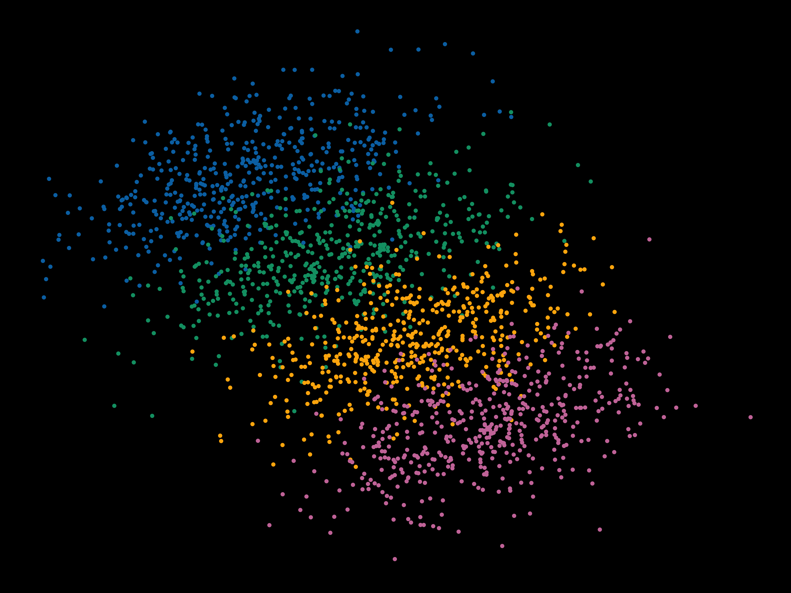
Multilevel Modeling Day 1
Violet Brown

Slide 2
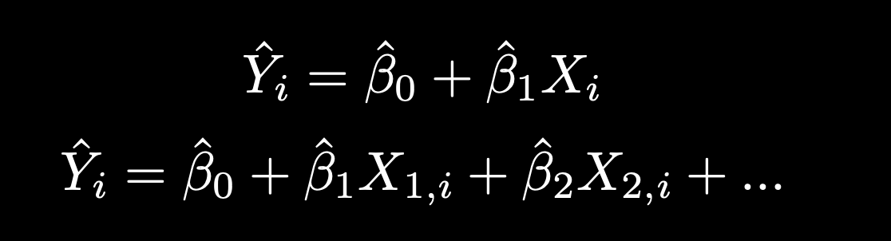
Standard regression equation:

Slide 3
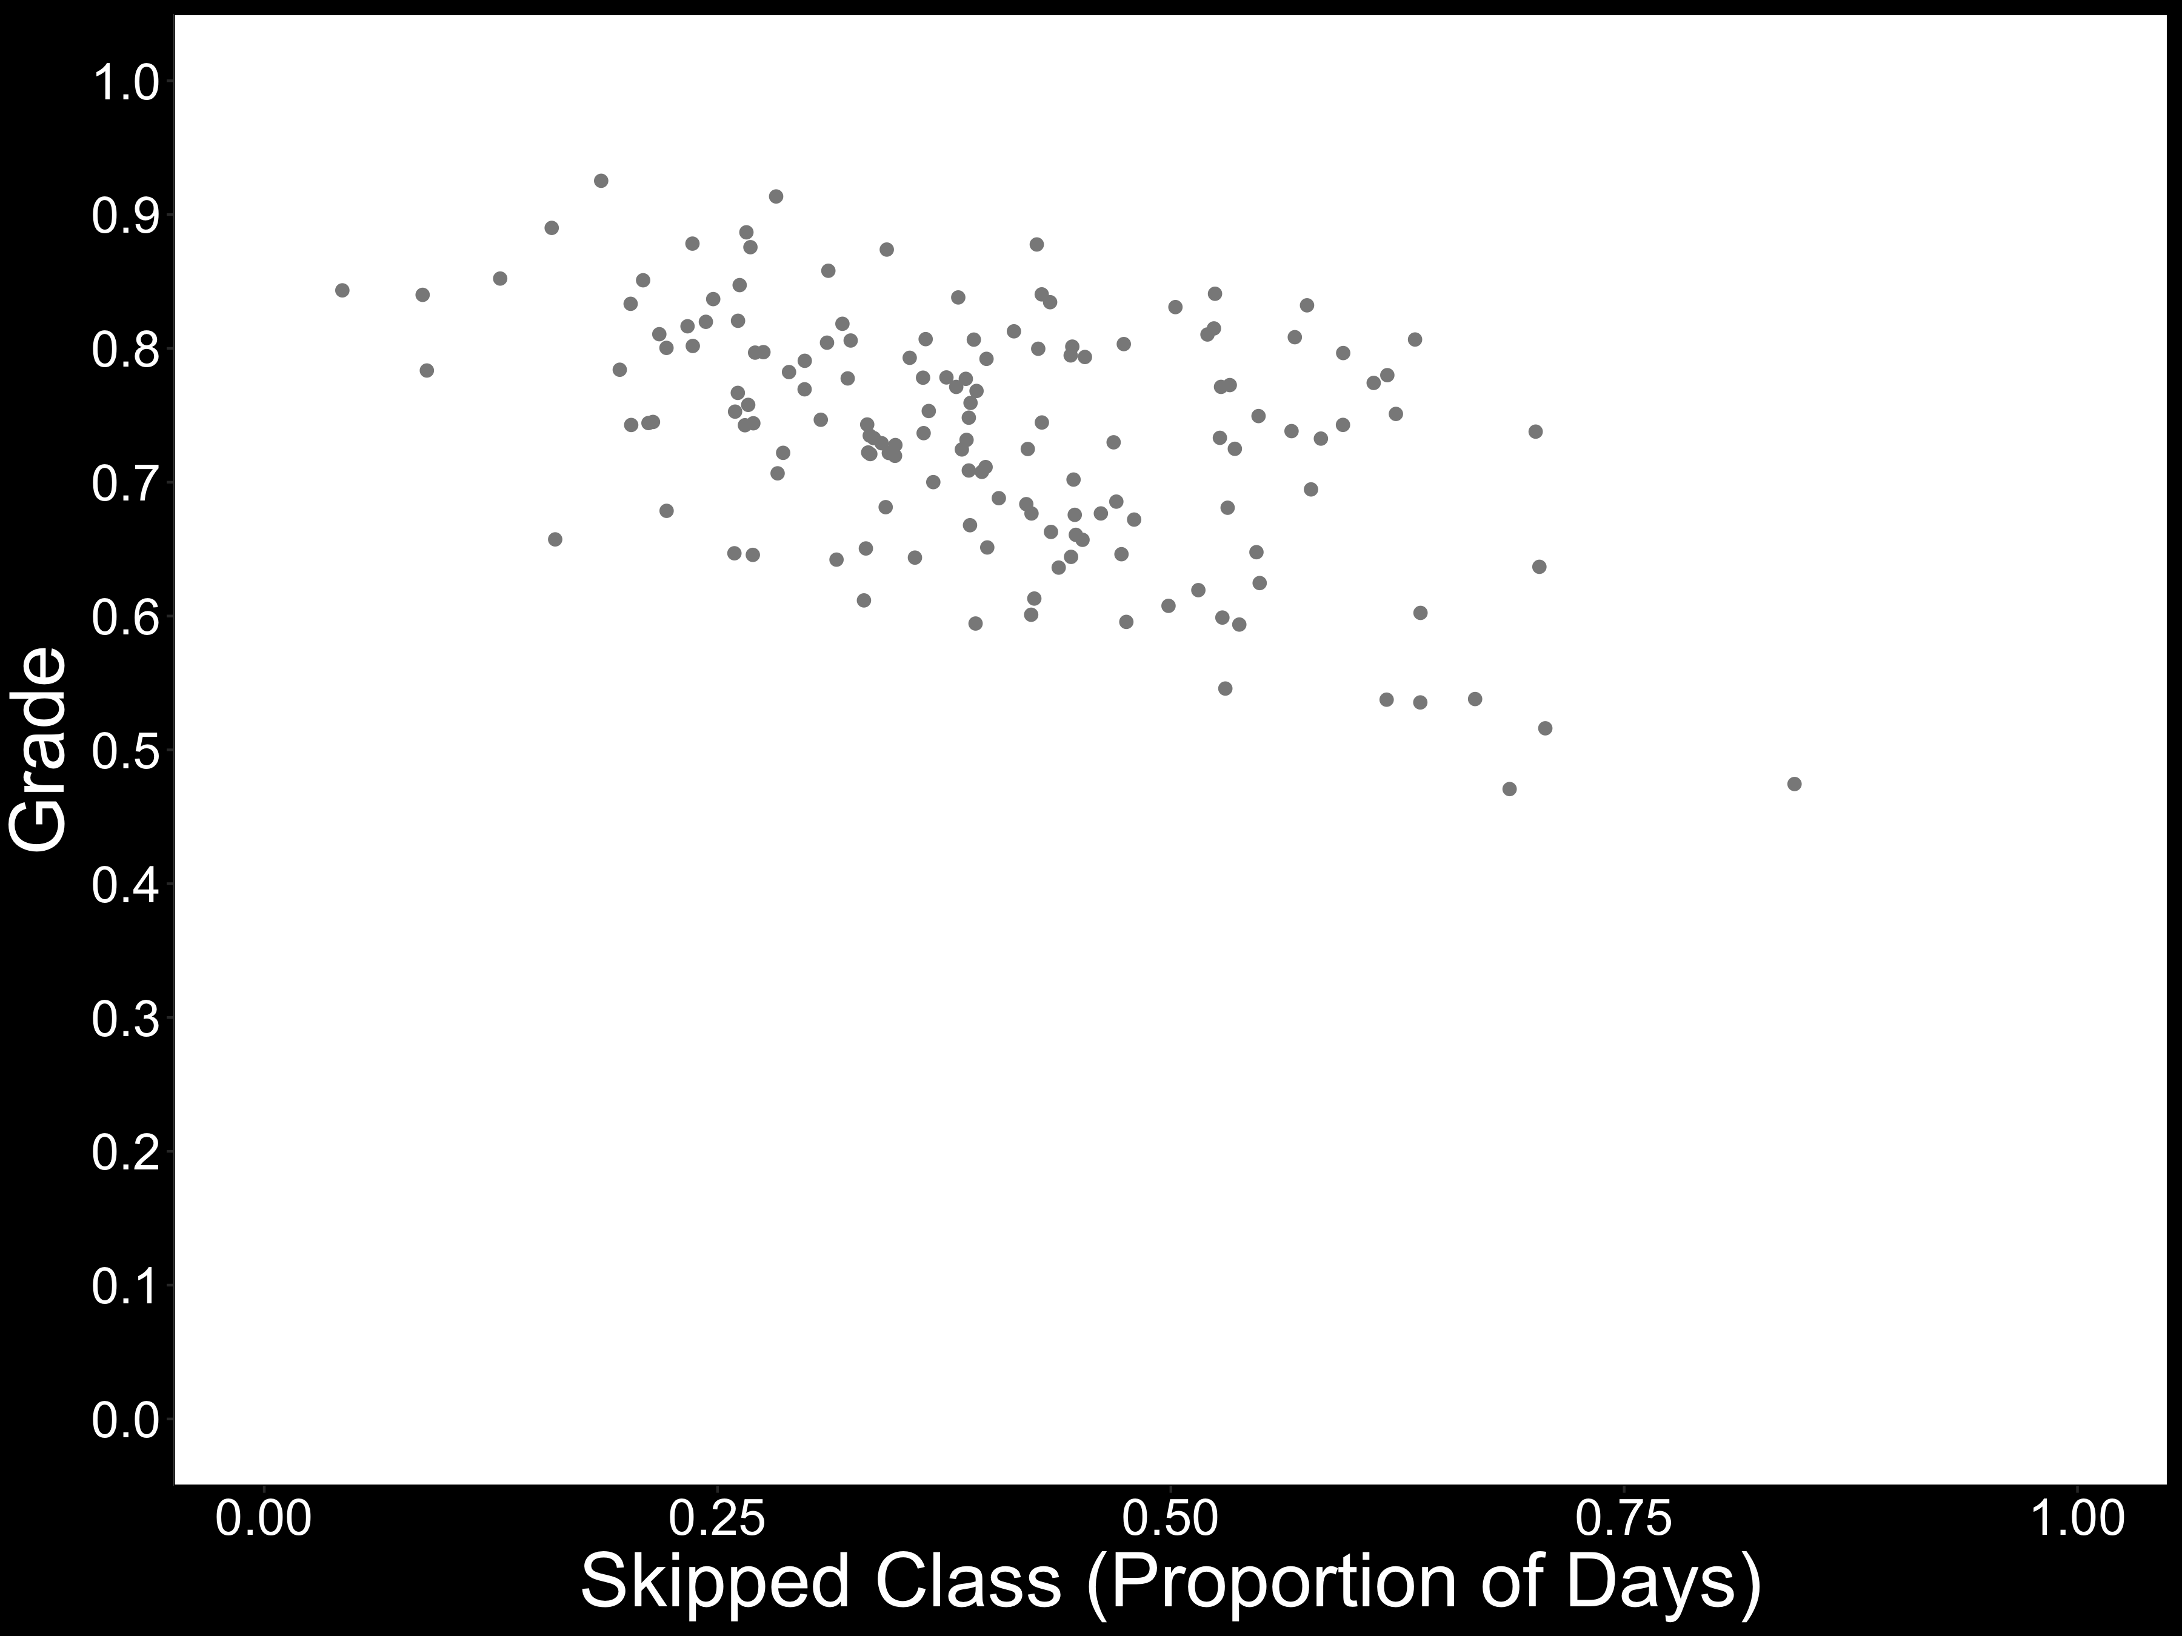

Slide 4
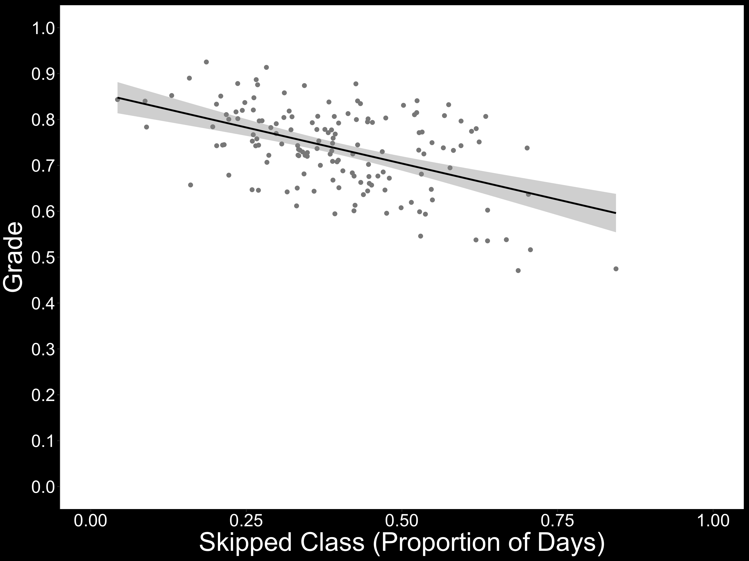

Slide 5
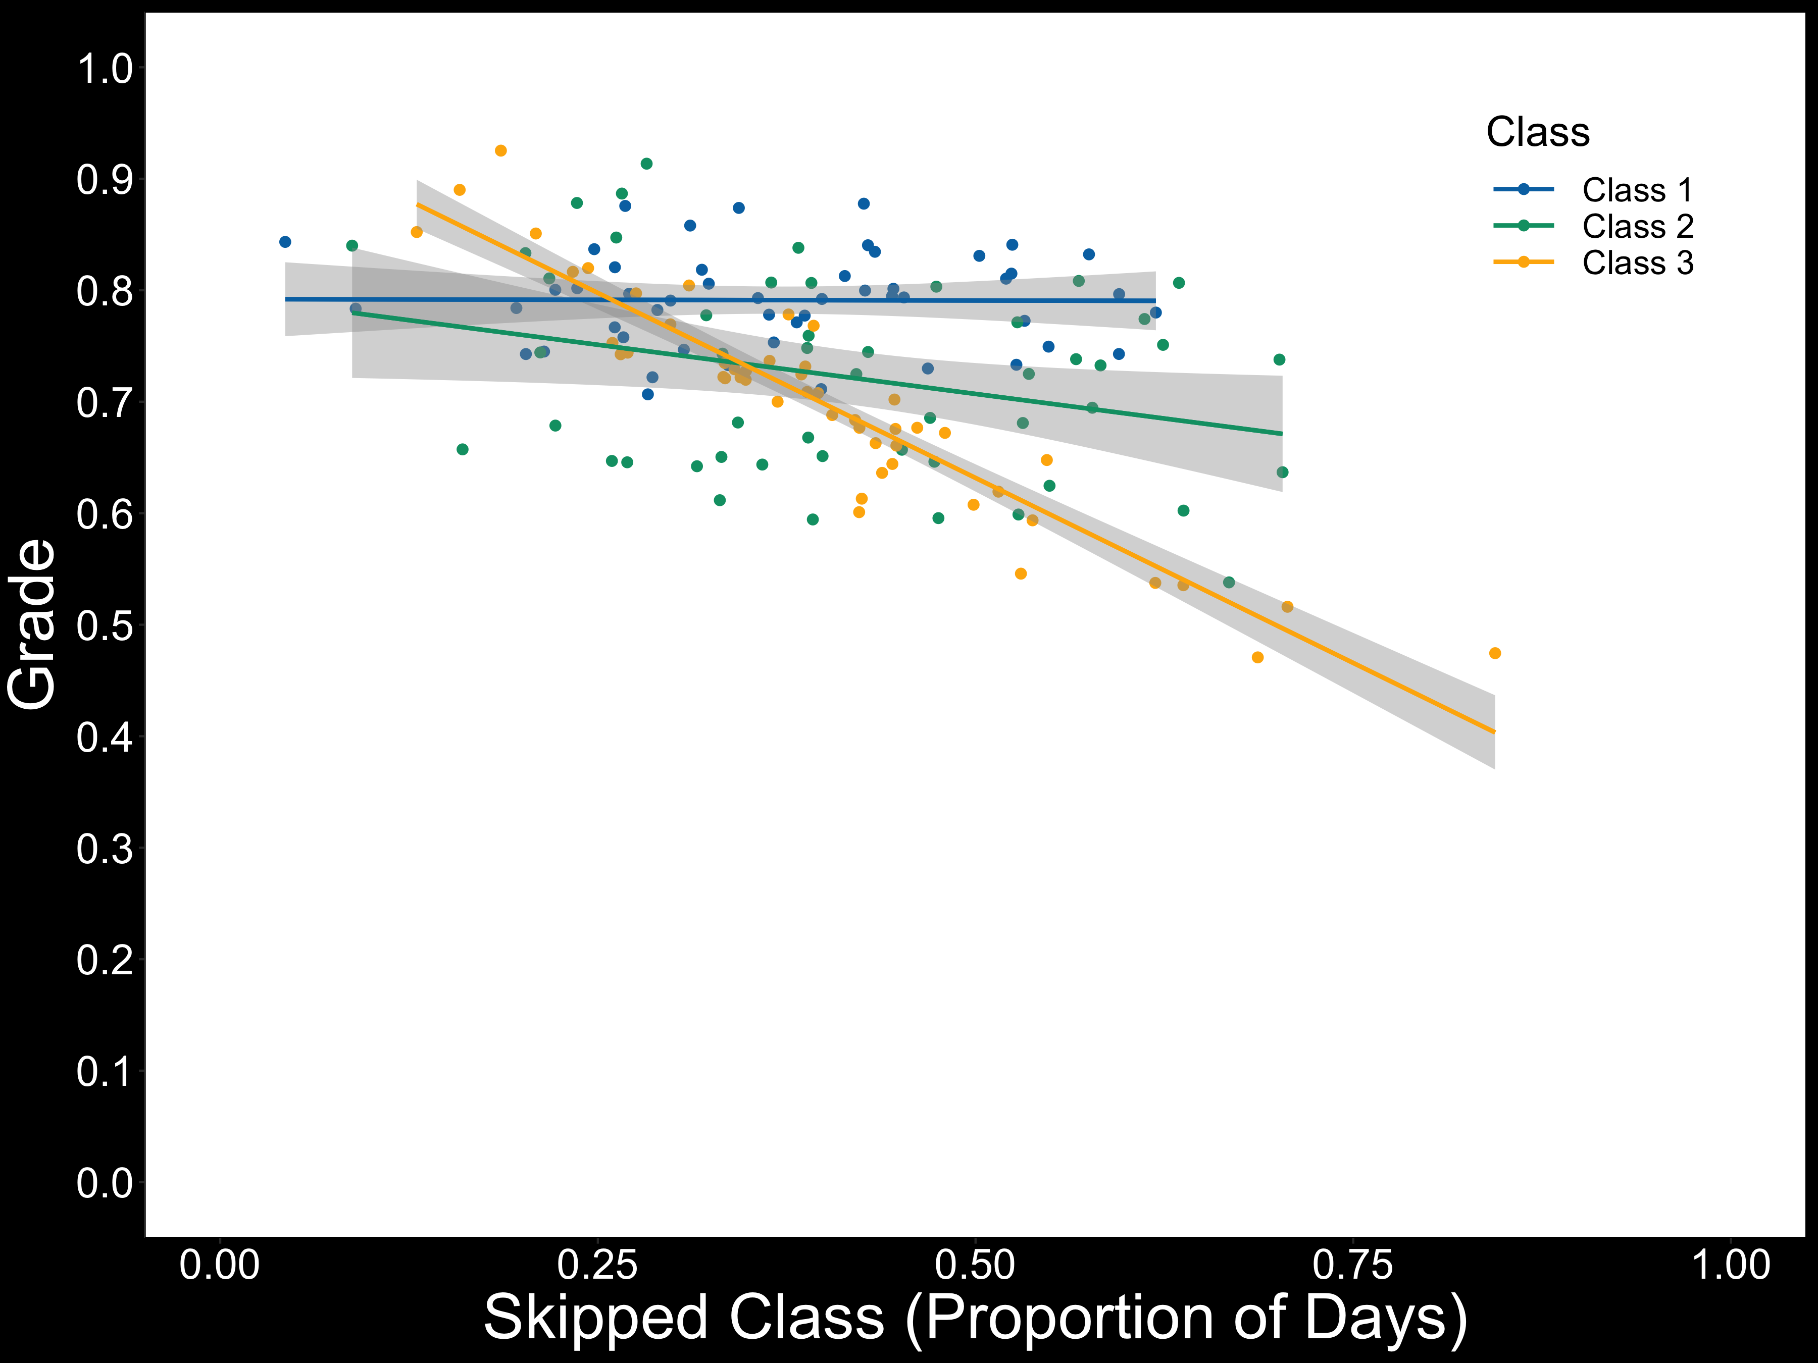

Slide 6
Regression assumptions
Normality assumption: normally distributed residuals
Homogeneity of variance (i.e., homoscedasticity): variance around the regression line (i.e., residual error) is constant across levels of predictors

Slide 7
Regression assumptions
Normality assumption: normally distributed residuals
Homogeneity of variance (i.e., homoscedasticity): variance around the regression line (i.e., residual error) is constant across levels of predictors
Independence assumption: errors are not correlated

Slide 8
The independence assumption
Violating it is bad
Amounts to artificially inflating sample size

Slide 9
The independence assumption
Violating it is bad
Amounts to artificially inflating sample size
Standard error estimates ↓
Type I error ↑ (e.g., Winter, 2011; 2015)
FALSE POSITIVES

Slide 11
So you have dependencies in your data...now what?
Design choices (e.g., one student per class)
Reduces statistical power
Isn't feasible for some experiments (e.g., response time studies)

Slide 12
So you have dependencies in your data...now what?
Design choices (e.g., one student per class)
Reduces statistical power
Isn't feasible for some experiments (e.g., response time studies)
Aggregation (i.e., means are entered into the analysis)
The model will underestimate variability

Slide 14
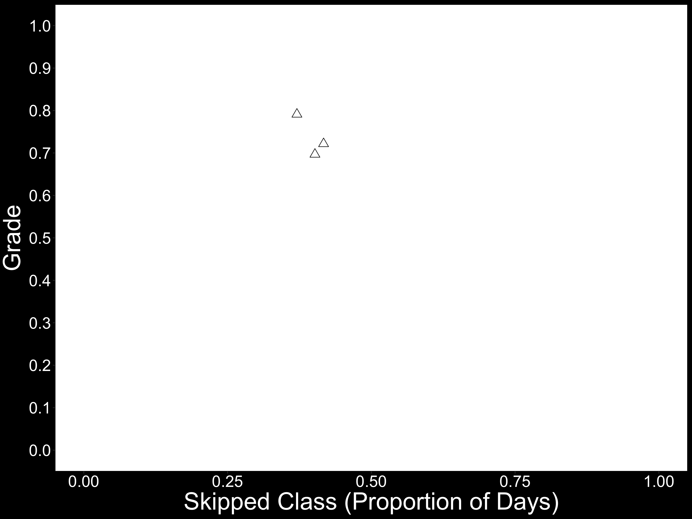

Slide 15
So you have dependencies in your data...now what?
Design choices (e.g., one student per class)
Reduces statistical power
Isn't feasible for some experiments (e.g., response time studies)
Aggregation (i.e., means are entered into the analysis)
The model will underestimate variability
You lose information about variability within the grouping factor
The model has less information to work with!

Slide 16
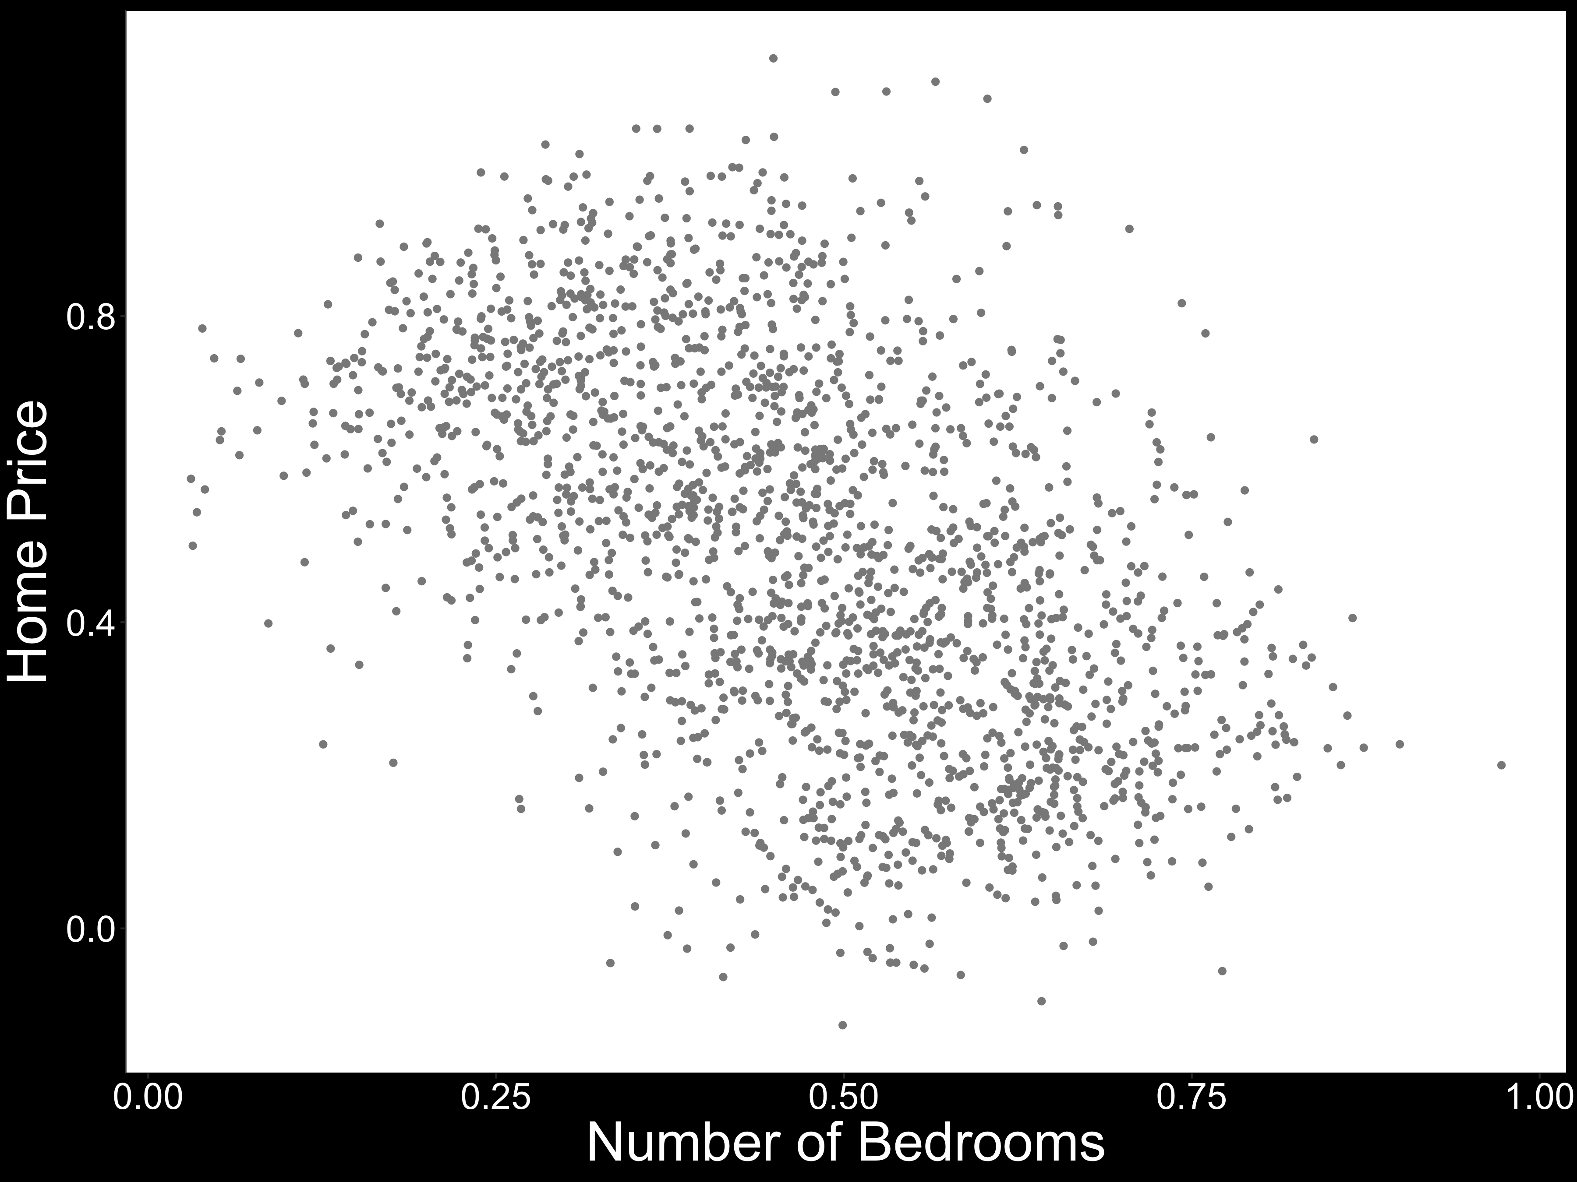

Slide 17
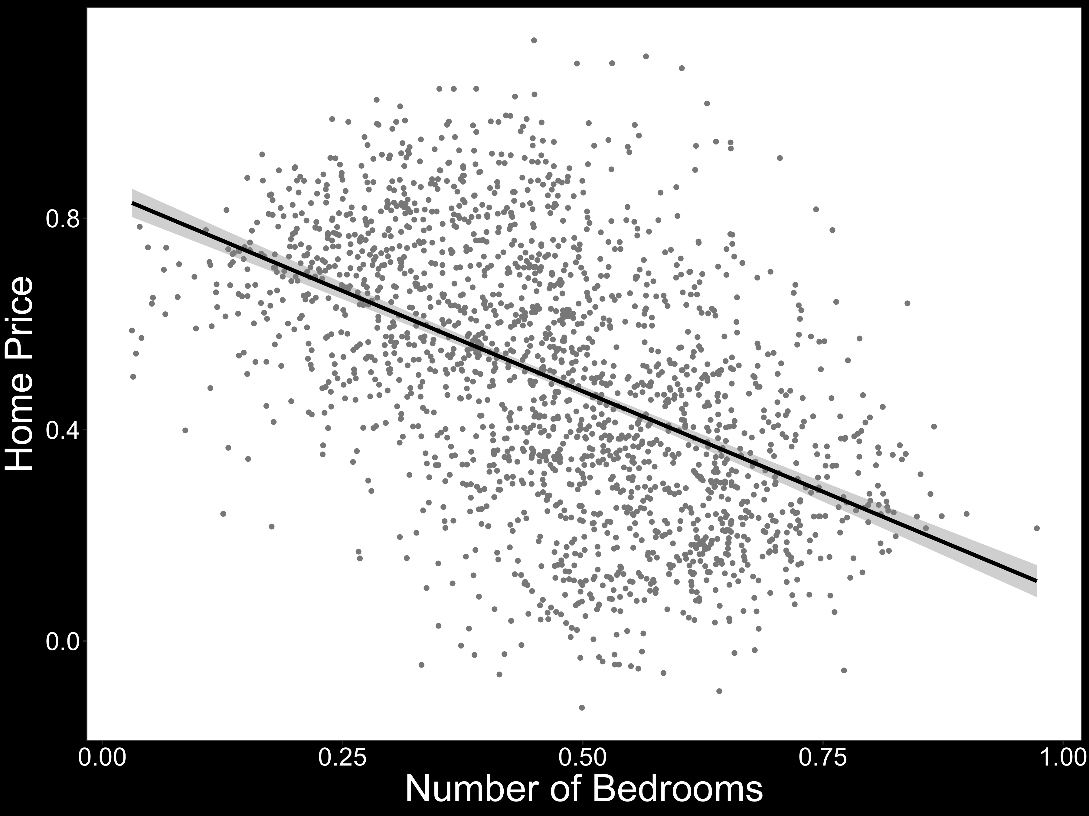
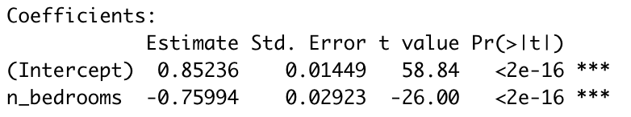

Slide 18
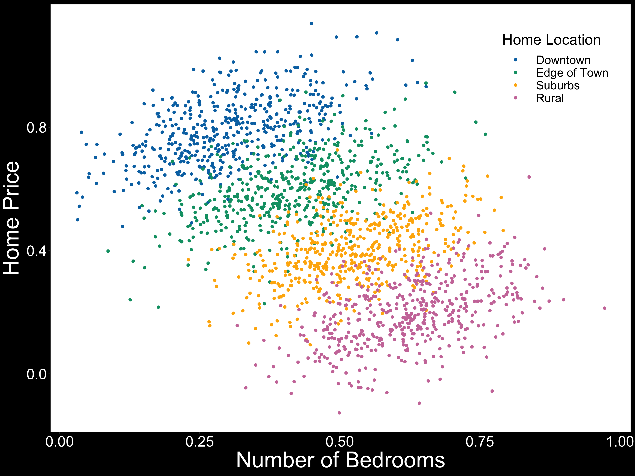

Slide 19
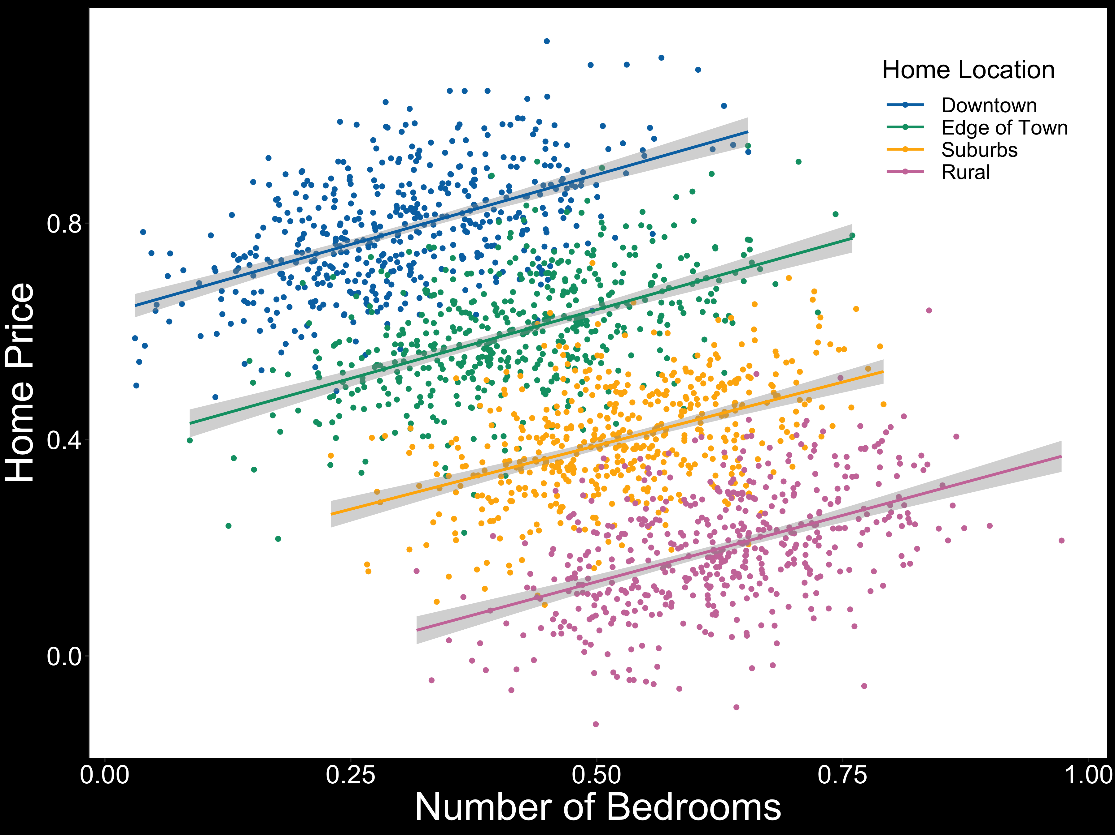

Slide 20
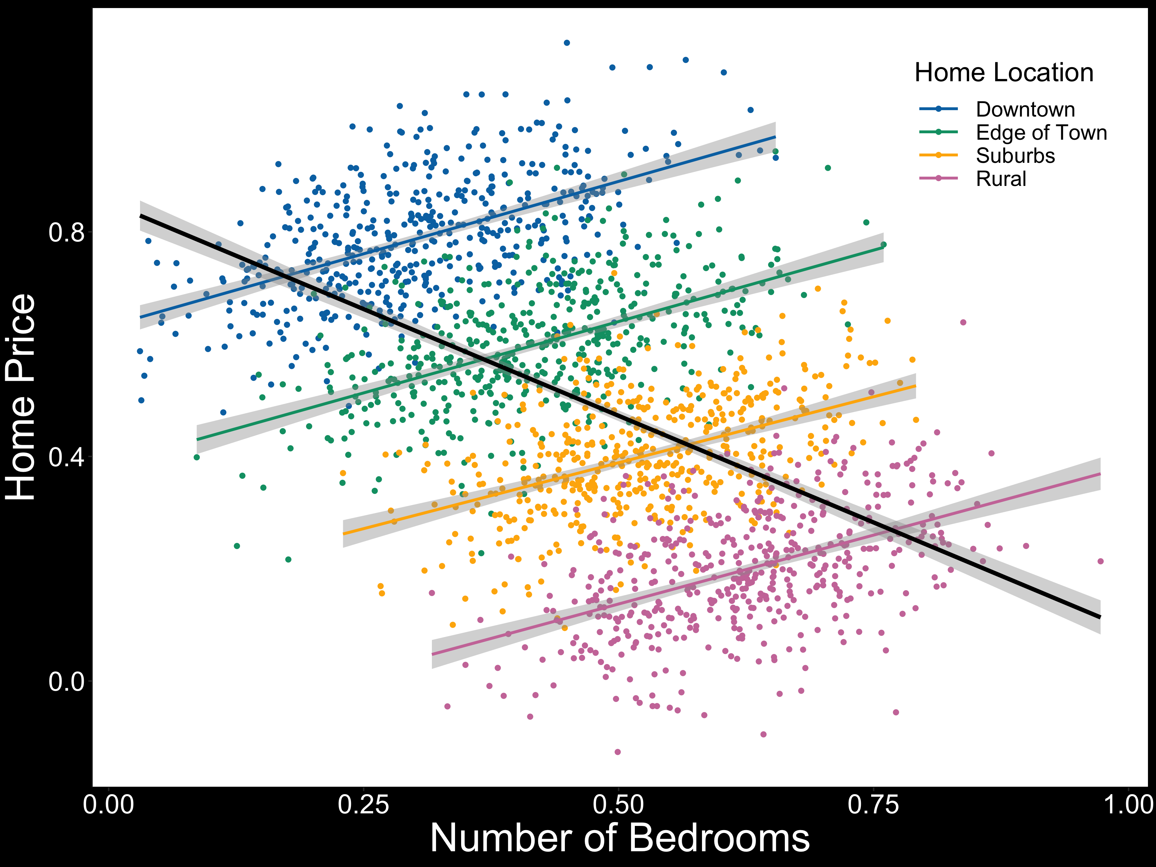

Slide 21
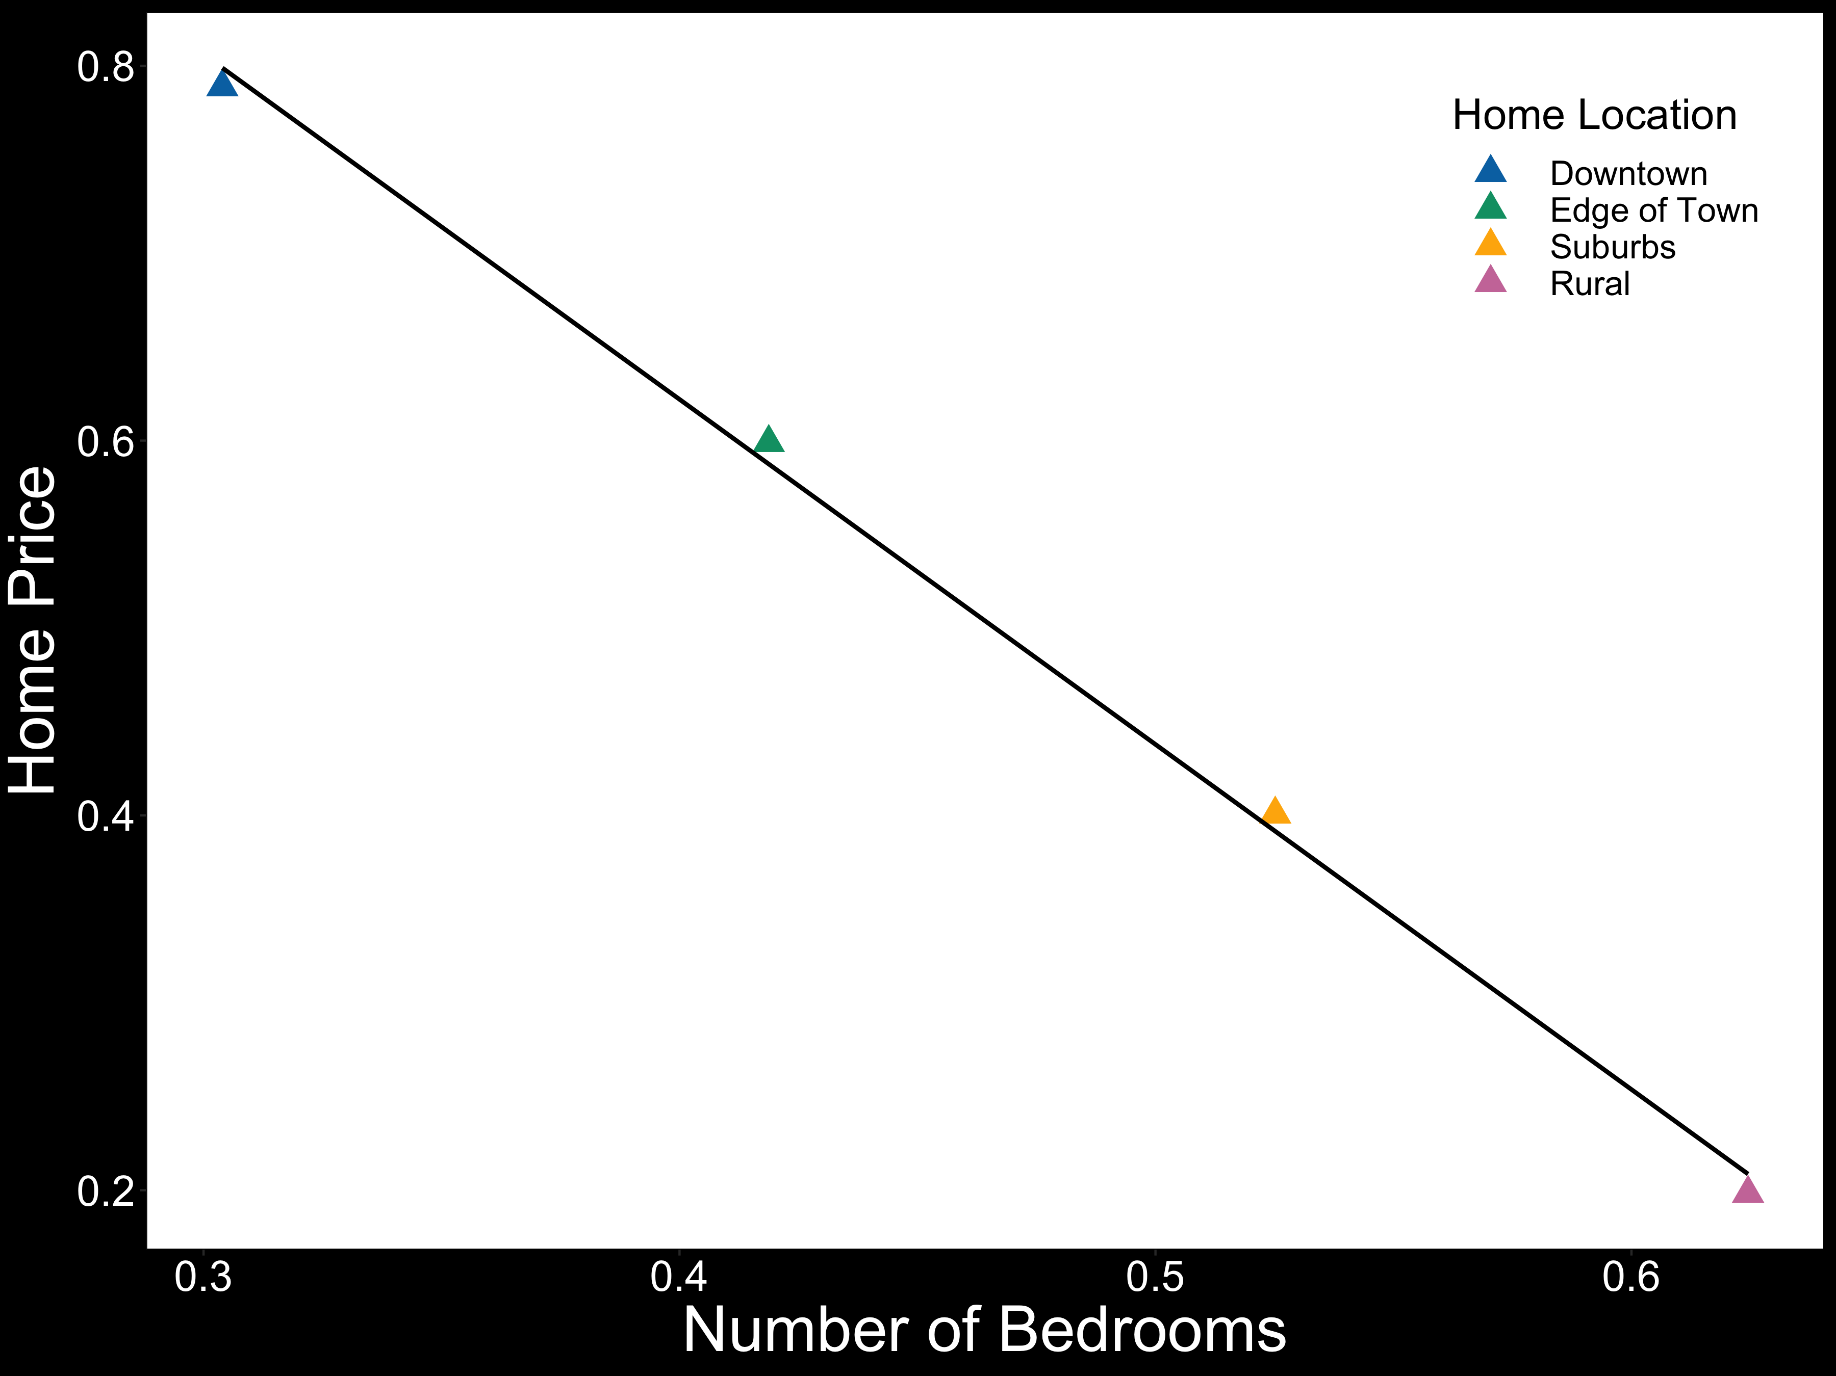

Slide 23
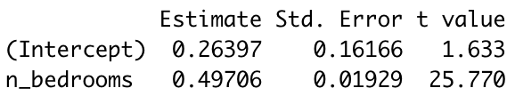

Slide 24
Repeated measures ANOVAs
Do not tell you about the direction or magnitude of the effect
Aggregate across either participants or items

Slide 25
Repeated measures ANOVAs
Do not tell you about the direction or magnitude of the effect
Aggregate across either participants or items
By-participant and by-item analyses can produce different results

Slide 26
Repeated measures ANOVAs
Do not tell you about the direction or magnitude of the effect
Aggregate across either participants or items
By-participant and by-item analyses can produce different results
Assume continuous dependent variable and categorical independent variables

Slide 27
Repeated measures ANOVAs
Do not tell you about the direction or magnitude of the effect
Aggregate across either participants or items
By-participant and by-item analyses can produce different results
Assume continuous dependent variable and categorical independent variables
LMER is more flexible; framework extends to glm

Slide 28
Mixed-effects models take the stage
Examples of nesting and dependencies:
Students within classes (within schools!)
Observations within people

Slide 29
Mixed-effects models take the stage
Examples of nesting and dependencies:
Students within classes (within schools!)
Observations within people
Observations within items
People within counties (within states!)
Etc. etc.
Mixed models can simultaneously model multiple dependencies

Slide 30
Fixed and random effects
Fixed effects: population-level (i.e., average) trends that should persist across experiments
Random effects: cluster-level trends

Slide 31
Fixed and random effects
Fixed effects: population-level (i.e., average) trends that should persist across experiments
Random effects: cluster-level trends
Clusters of dependent data points coming from the same higher-level group (e.g., participant, item, classroom, school)
Particular participants or items may behave differently from the average trend

Slide 34
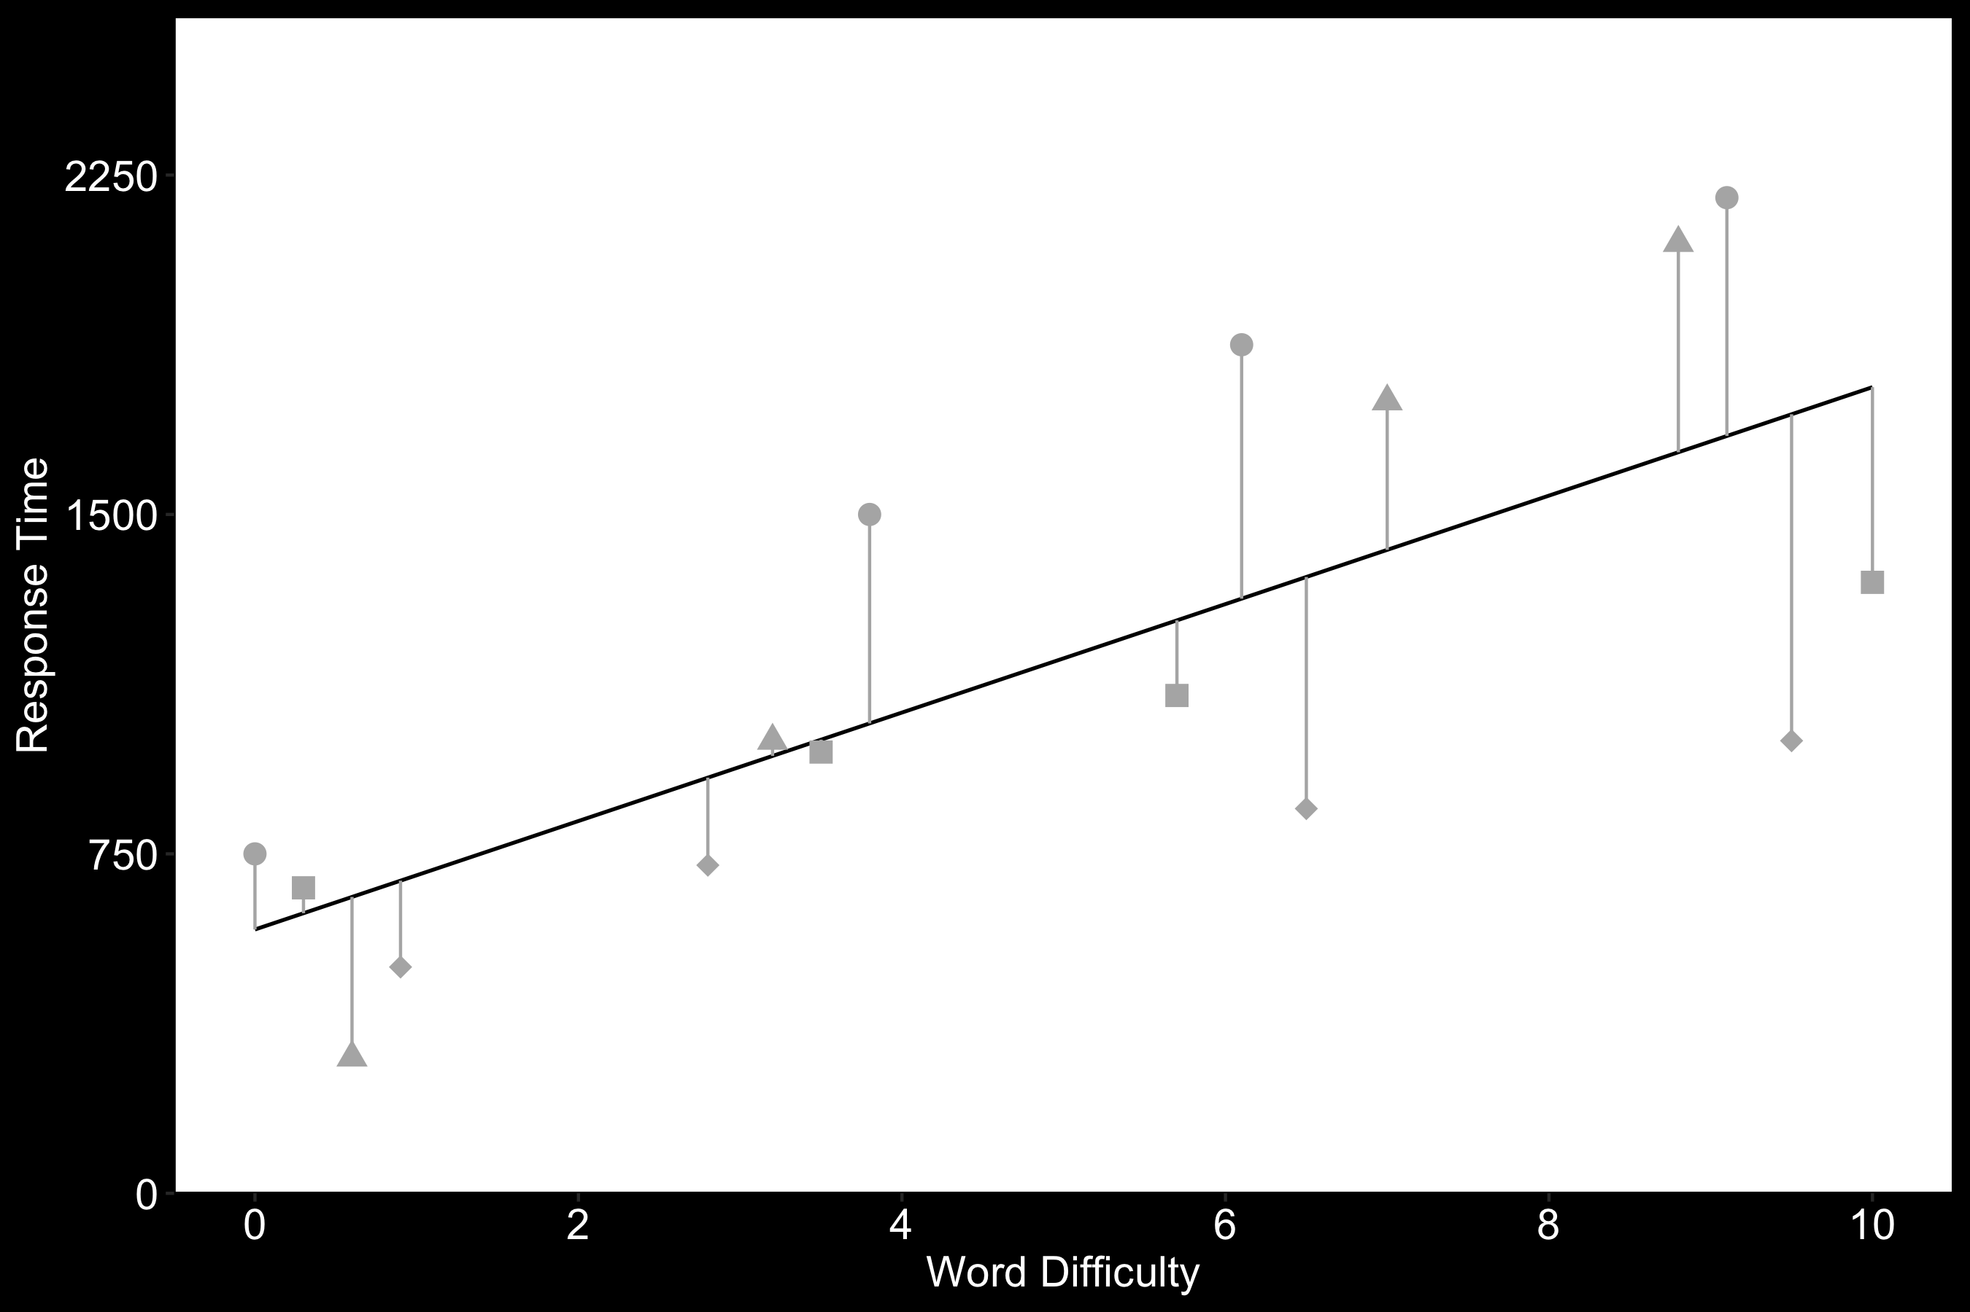
Fixed effects only regression

Slide 35
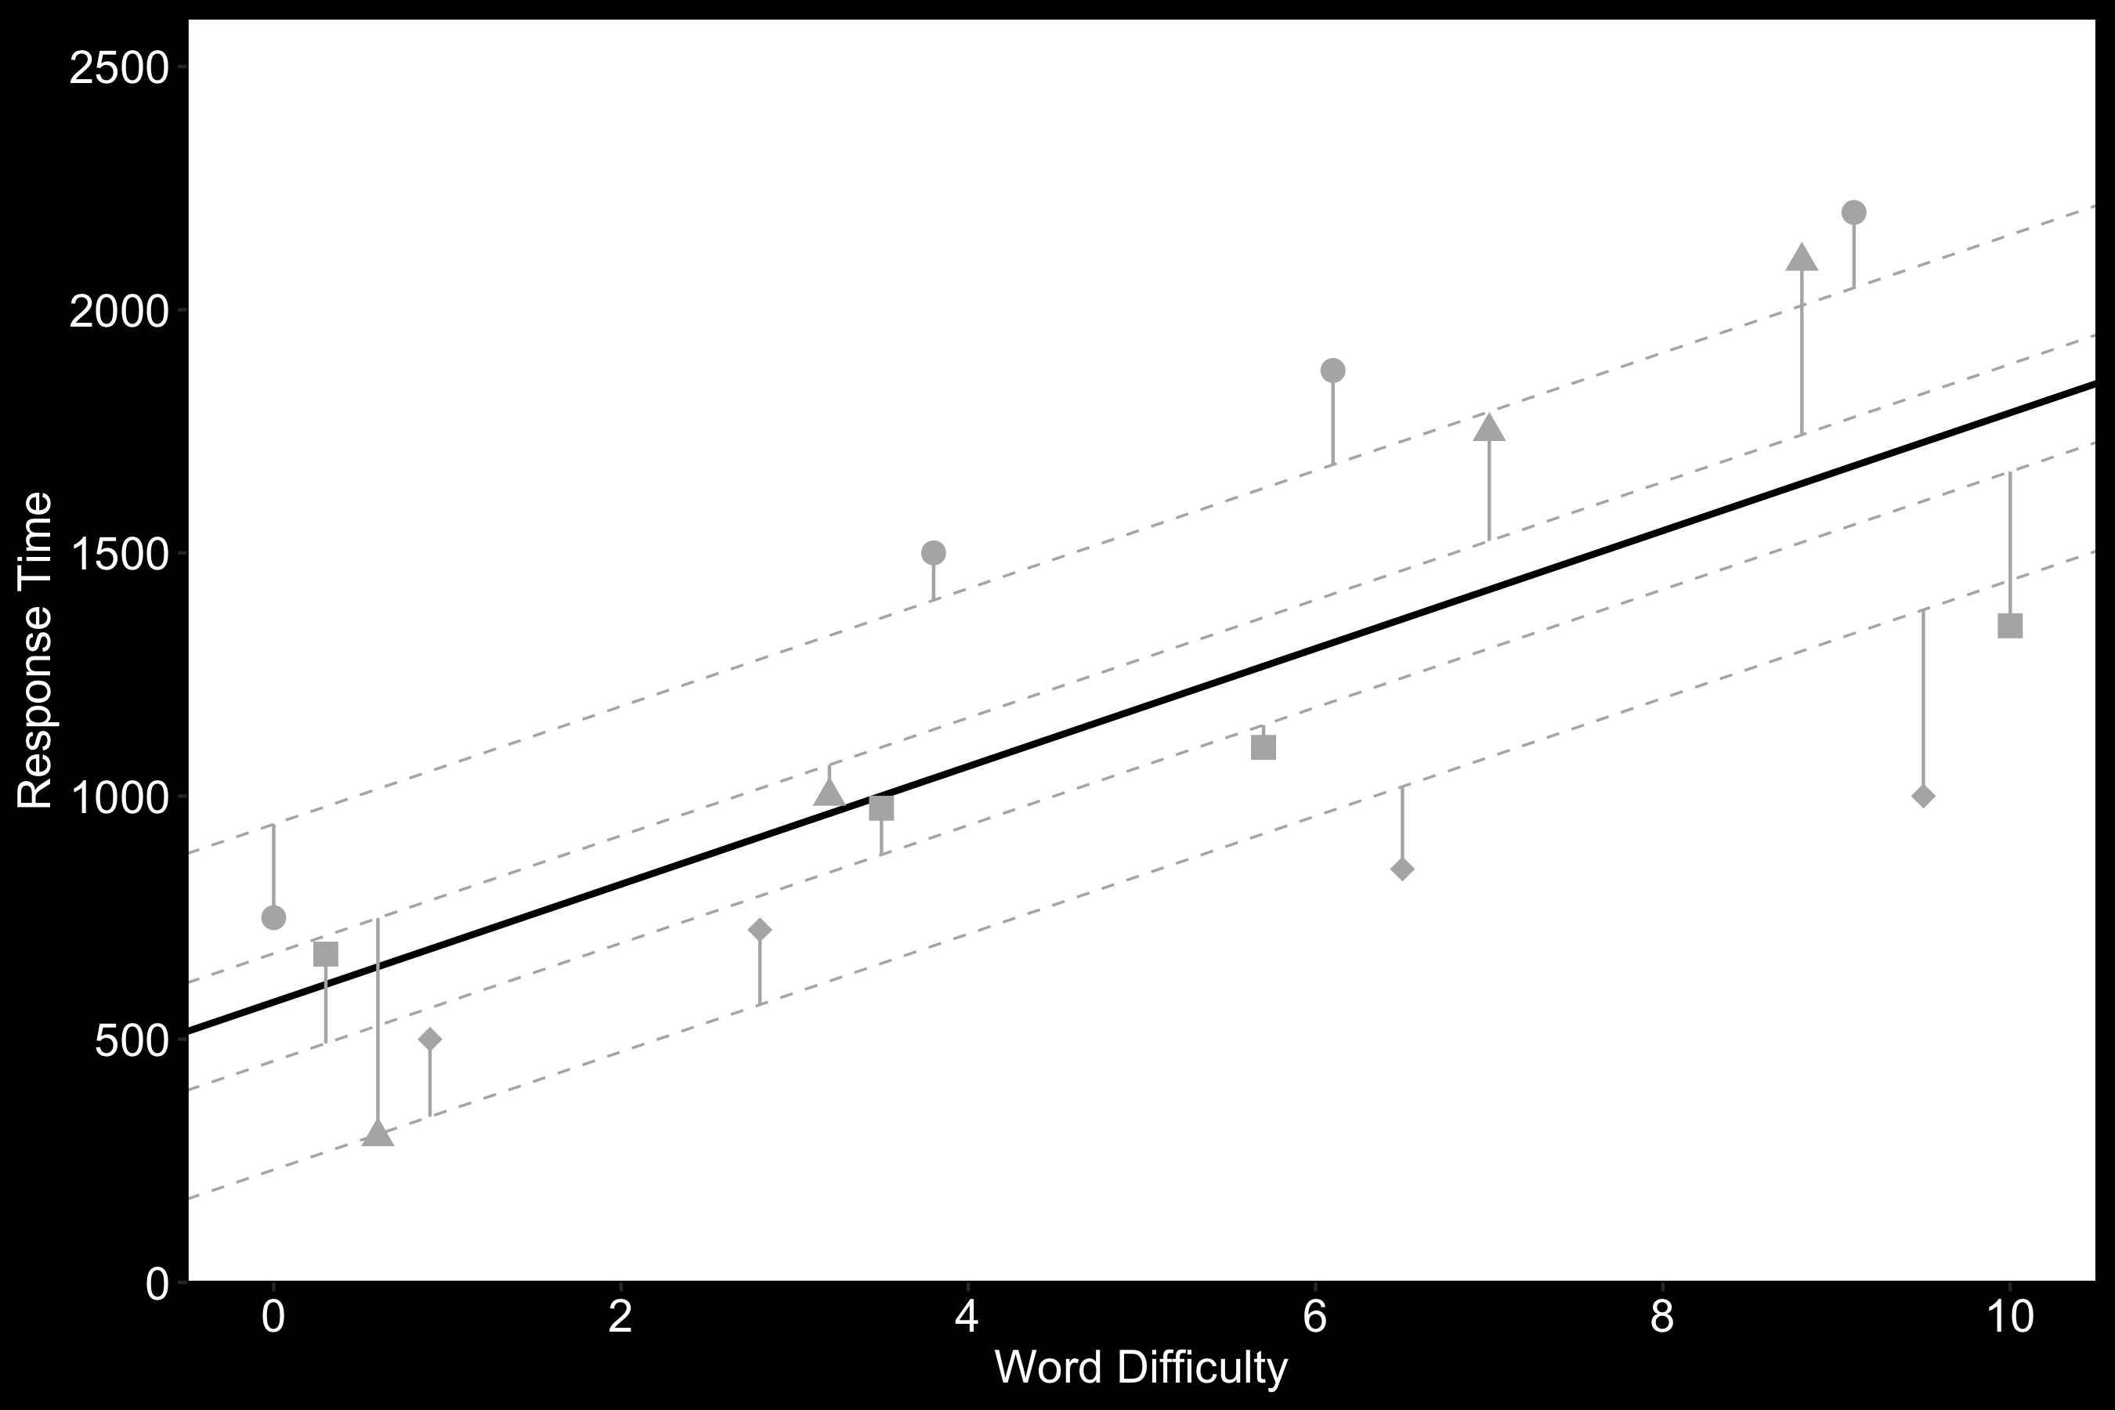
Adding random intercepts

Slide 36
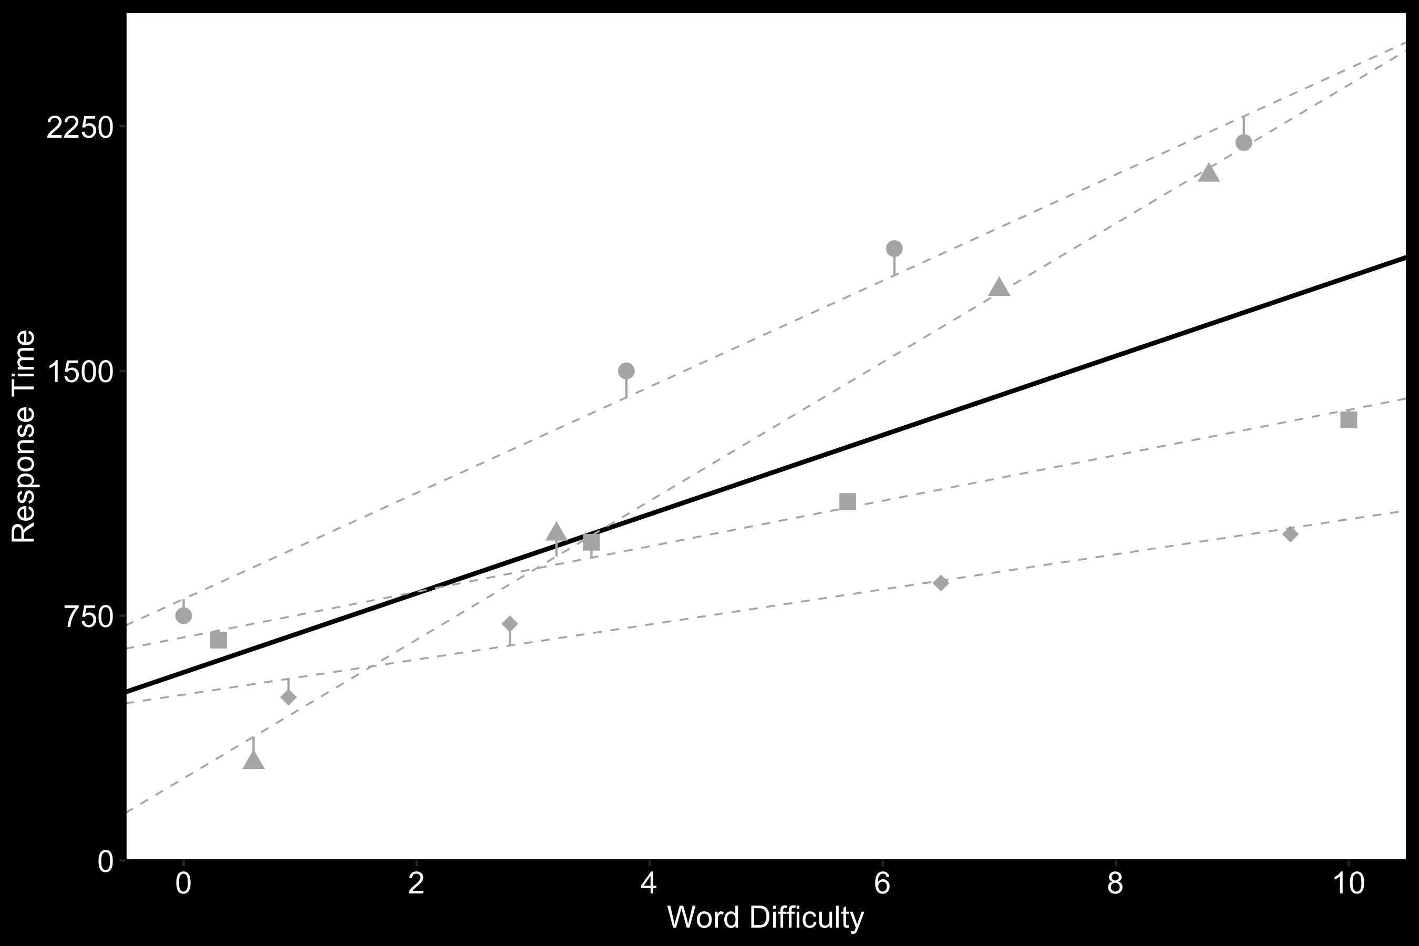
Adding random slopes

Slide 37
Summary
The independence assumption is important
Aggregation masks variability
Repeated-measures ANOVAs have issues
Mixed-effects models are the answer

Slide 38



Summary
The independence assumption is important
Aggregation masks variability
Repeated-measures ANOVAs have issues
Mixed-effects models are the answer
Fixed and random effects

